Slide 1
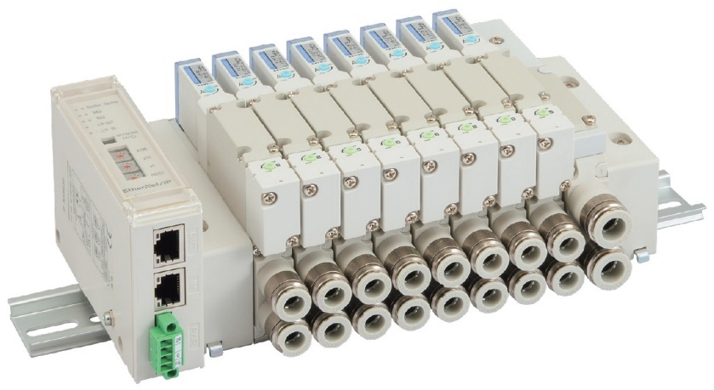
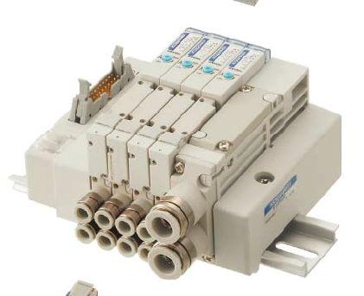
F-SERIES VALVE
Serial Transmission Including:
EtherNET/IP • Device Net • EtherCat
Quick Delivery! F10 & F15 Series in Stock and Assembled in Franklin, MA
10mm | 15mm | 18mm

Slide 2
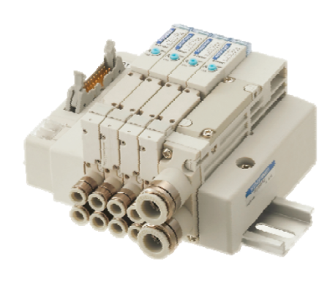
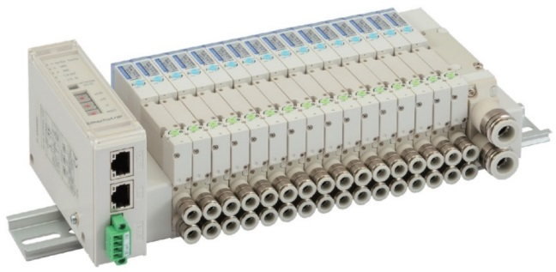
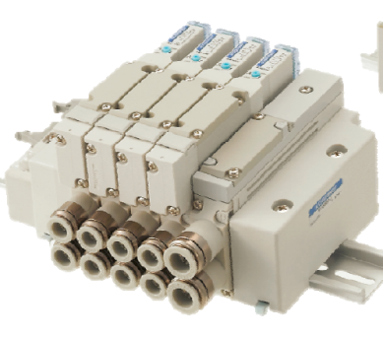
F10 SERIES
Available as:
Single Valve Unit
Monoblock Base or Direct Piping
Monoblock PC Board Manifold
Split Manifold w/ Plug in or Non Plug In Type
Serial Transmission
25 pin & 37 pin Dsub
5 Ports and Tandem 3 Ports available • Single & Double Solenoid
3 Position available with Closed Center, Exhaust Center or Pressure Center
Field Selectable between double solenoid or single solenoid.
Field Selectable Base or Direct piping.
F15 SERIES
Available as:
Single Valve Unit
Monoblock Base or Direct Piping
Monoblock PC Board Manifold
Split Manifold w/ Plug in or Non Plug In Type
Serial Transmission
25 pin & 37 pin Dsub
5 Ports and Tandem 3 Ports available • Single & Double Solenoid
3 Position available with Closed Center, Exhaust Center or Pressure Center
Field Selectable between double solenoid or single solenoid.
Field Selectable Base or Direct piping.

Slide 3
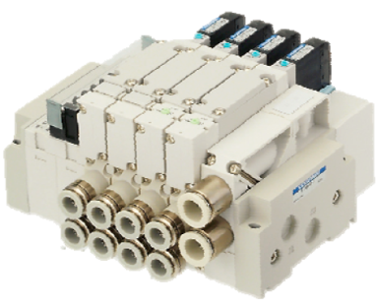
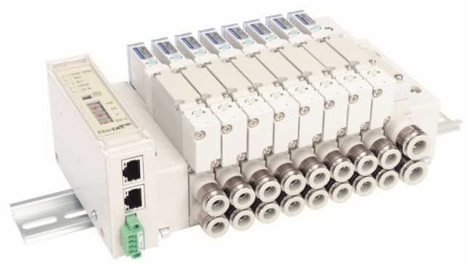
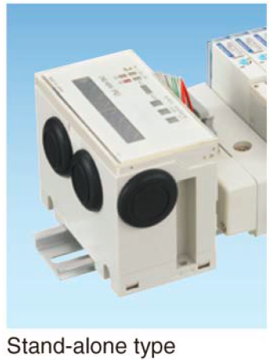
F18 SERIES
Available as:
Single Valve Unit
Monoblock Base or Direct Piping
Monoblock PC Board Manifold
Split Manifold w/ Plug in or Non Plug In Type
Serial Transmission
25 pin & 37 pin Dsub
5 Ports • Single & Double Solenoid
3 Position available with Closed Center, Exhaust Center or Pressure Center
Field Selectable between double solenoid or single solenoid.
Field Selectable Base or Direct piping.
SERIAL TRANSMISSION
EtherNET/IP • Device Net • EtherCAT
Other serial communication supported:
Omron
CC-Link
DeviceNet
CompoNet

Slide 4
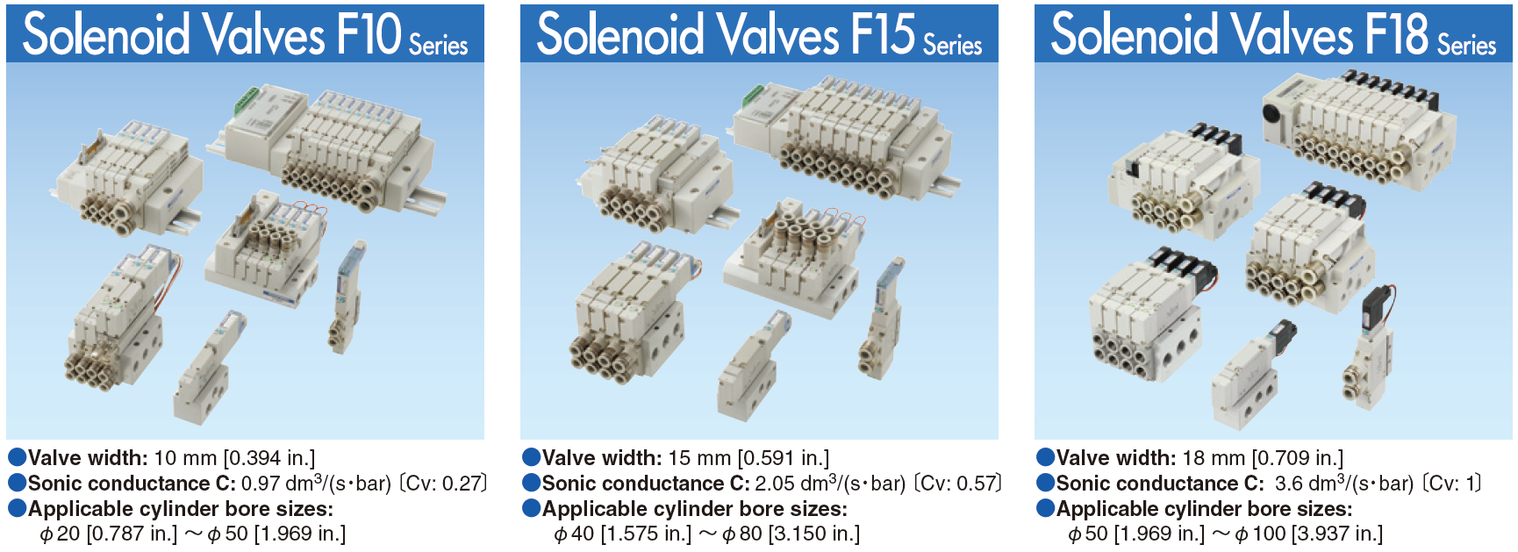
F-SERIES:
BLOCK MANIFOLD & DIN RAIL (PLUG-IN & NON-PLUG-IN)
CHANGEABLE FITTING BLOCK (MANIFOLD or DIRECT)
DUAL USE PUSH TO CONNECT FITTINGS
TANDEM 3 PORT VALVE (3 MODELS)
0.1W LOW WATT COIL AVAILABLE
BACK PRESSURE VALVE OPTION
MUCH MORE!
AirInc.net
8 Forge Pkwy Franklin, MA 02038-3135
Toll-Free: 800-341-2800
sales@airinc.net
© 2017 KOGANEI International America, Inc., All Rights Reserved.

